Slide 1
STUDENT INFORMATION SYSTEM
Guide: Dr.N.Mangathayaru (Professor,ITDept)
Team-38
19071A12C7-PRAHARSHIKA
19071A12D3-DEEPTHI
19071A12H0-SATWIKA

Slide 2
ABSTRACT
Student management system is to create an application that can provide a query management system through android mobile phones. As teacher staff there will be reduced manual work they can easily upload the exam timetable and respective subject notices. Student Information Management System provides a simple interface for maintenance of student information. It can be used by educational institutes or colleges to maintain the records of students easily.

Slide 3
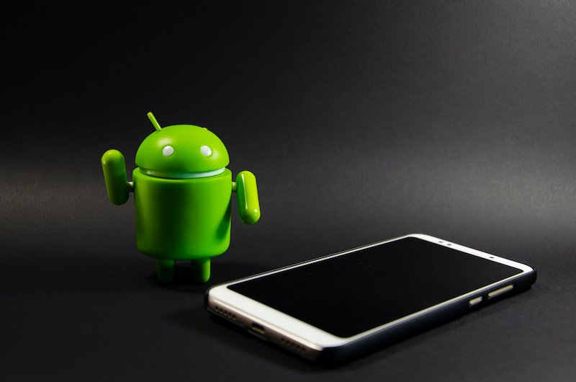
INTRODUCTION
The Student Information System (SIS) would be a new way of record management that would achieve efficiency on processing student information. The administrator will use the application to enter their personal and details of student and faculty.

Slide 4
EXISTING SYSTEM
1. Infinite Campus.
2. Quick Schools.
3. My Class Campus.
4. Vidyalaya.

Slide 5
PROPOSED SYSTEM
The proposed system has an android app or a web services, where the user can login to perform operations. It contains the following activities, which try to automate the entire process keeping in view of the database integration approach. We propose a schema of maintaining records
In college to maintain all student records they need have more staff and also place to maintain the records. Even maintained properly when ever required they are not available

Slide 6
SOFTWARE AND HARDWARE REQUIREMENTS
Software requirements:
Android studio, java, html
Hardware requirements:
RAM-3MB, Hard disk- 40GB

Slide 7
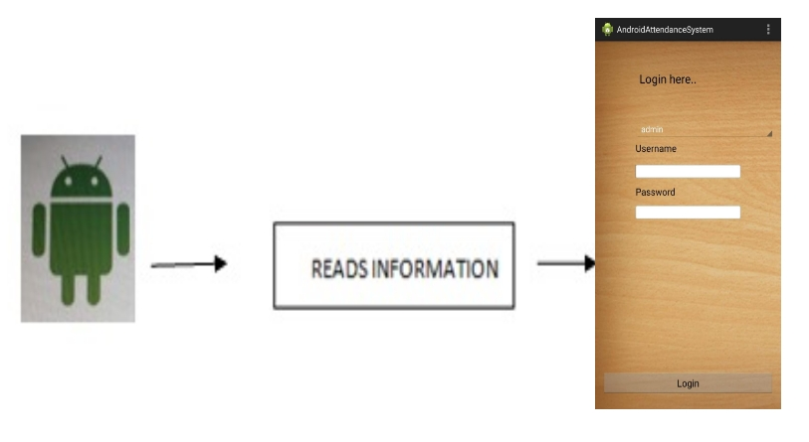
HOW IT WORKS?

Slide 8
METHADOLOGY
The methodology is divided to three main components which are literature review, creating a Graphical user interface (GUI) and finally is the software testing.

Slide 9
IMPLEMENTATION

Slide 10
1)Connect the cable to your android mobiles.
2)After running the code in android studio App gets opened in mobile.
3) First Login as a Student or a faculty using the username and password.
4)If we login as a Student manually enter student data(Firstname , Last name, phone number , DOB, Branch etc)that is to be stored.
5) The login details are to be creted by the Adminstrator for both the student and the faculty.

Slide 11
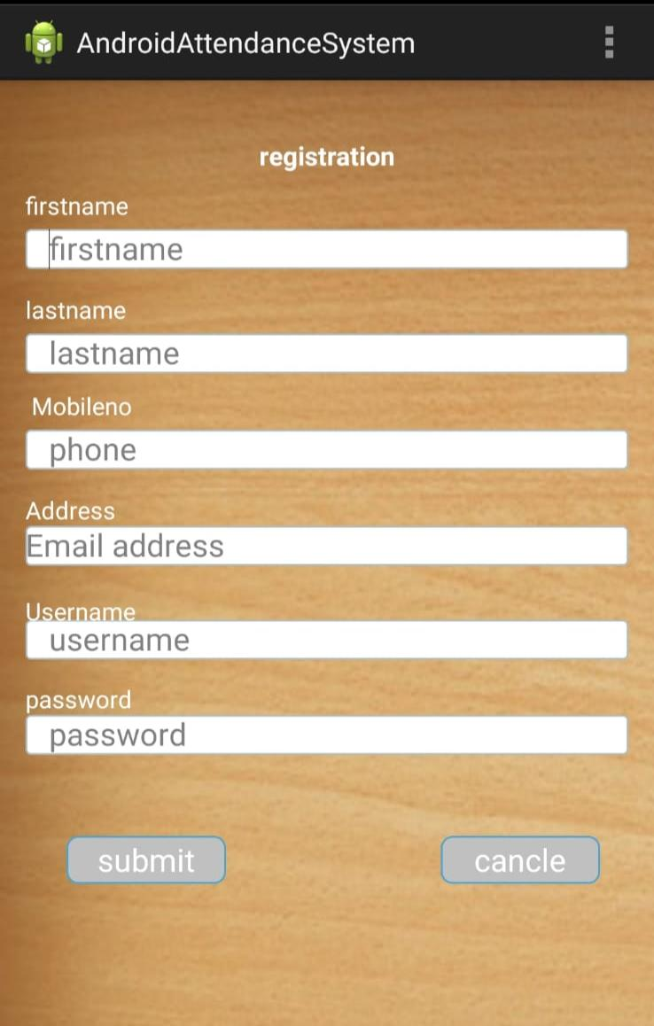
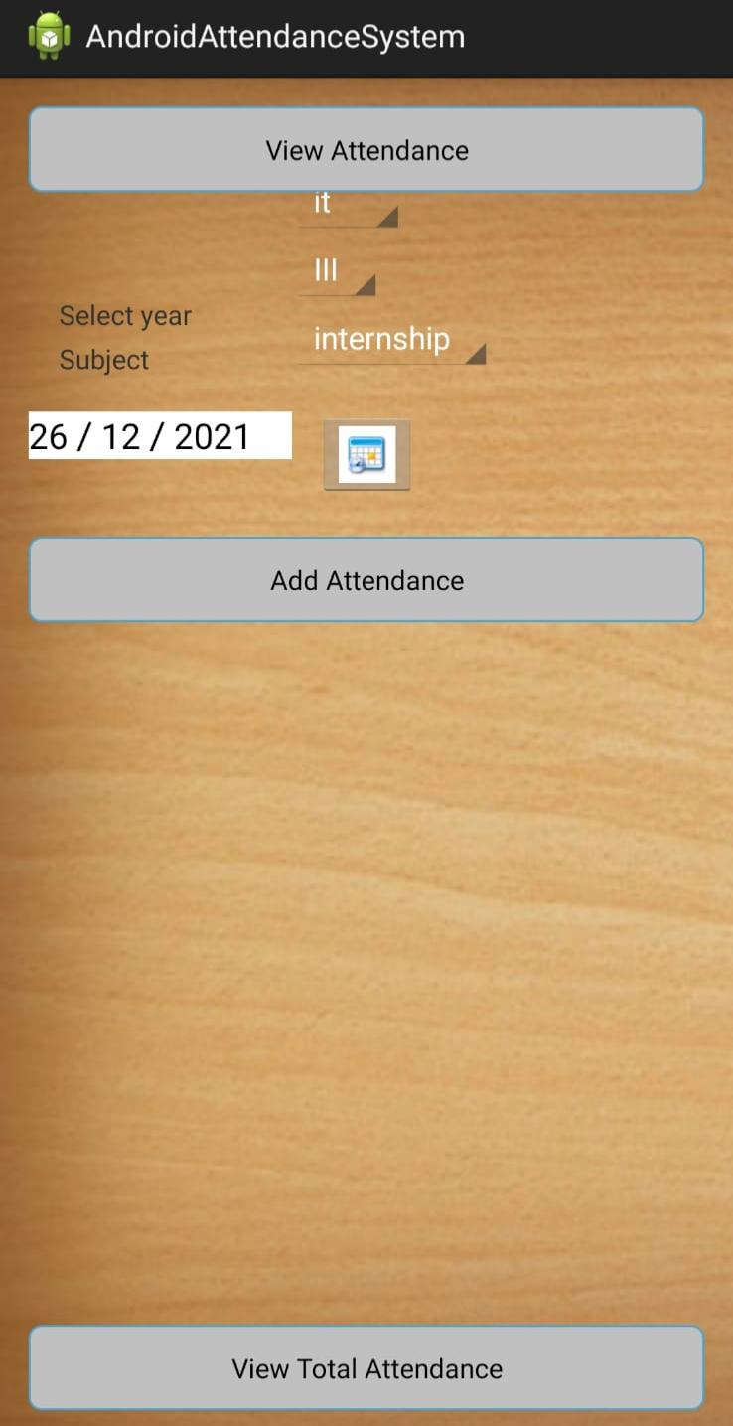

Slide 12
6) If we login as a Faculty then the attendance of the students can be updated by selecting the branch and the year of studying.
7) Select the date on which you want to update the attendance after selecting the student details.
8) After selecting the student details a Student database will be appeared , select the name and then we can mark as absent or present for the student.
9) After updating the attendance it can be viewed by clicking on the 'view attendance’ .
10) In this way the student details can be stored.

Slide 13

ADVANTAGES
In today's world, it is essential to manage the storage, transmission and analysis of information
1)An information system is defined as the software that helps organize and analyze data.
2)system work to coordinate scheduling and communications between faculty regarding students.

Slide 14
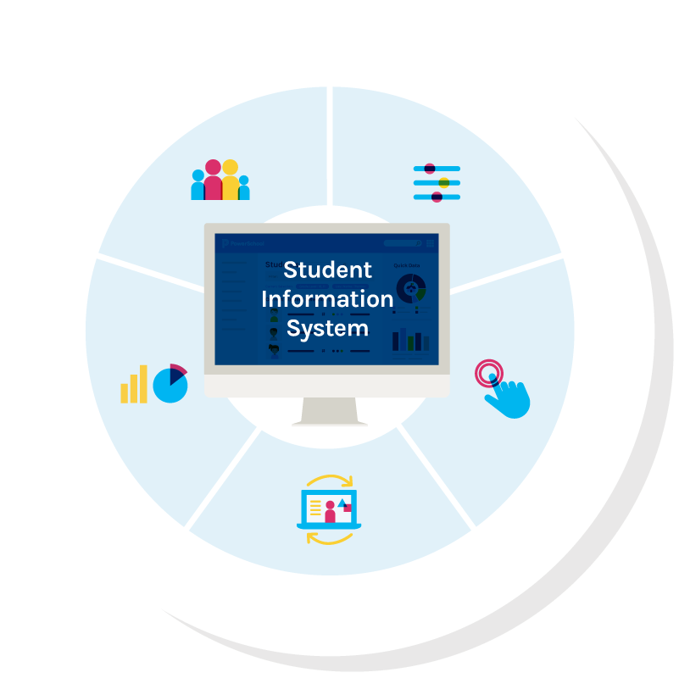


Slide 15
LIMITATIONS
The drawbacks in Student Management System software can be counted on fingers with mostly only benefits, these systems have a few countable downsides.
Often, applications face minor technical glitches and these systems are no exception but, ratification is immediate.

Slide 16
CONCLUSION
This project assists in automating the prevailing manual system. This is a paperless working model for future educational sector reforms. It can be monitored and controlled remotely. It will reduce the manpower required. It provides accurate information. The data which is stored in the repository may help in making intelligent decisions by the management. All the parents, teachers and management will get the specified data, which exactly facilitates the growing requirement for automation in educational systems.

Slide 17
FUTURE WORK
The project can be further expanded by adding CGPA and also by fetching the student data if required. Student credentials also can be added to the webpage and student inputs like profile photo, signature, automatic mailing options etc…can be taken into consideration. And also the attendance percentage can be calculated and displayed using graphs.

Slide 18
REFERENCES
We referred to many websites like code kshetra, editbits, geeks for geeks etc. referred to a few youtube channels and attended workshops on android development for building the app. And for the designing part we referred to a few books - The complete reference HTML & CSS by Thomas A. Powell and HTML5 & CSS3 by A Willey Brand.

Slide 19
THANK YOU

